Slide 1
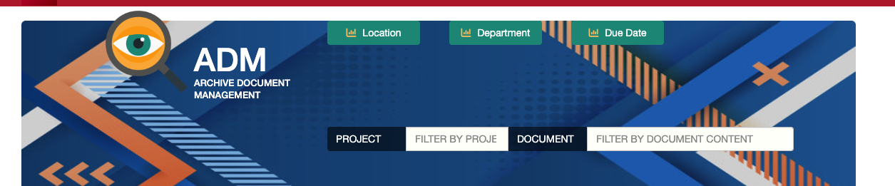

ADM User Guide
ADM Quick Guide for Document Storage and Management

Slide 2
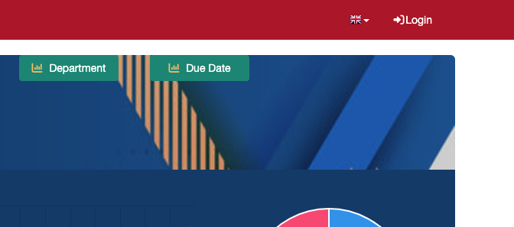
Accessing the Application
Navigating to the Web Site
Go to adm.quasarpm.com
Login
Enter your credentials

Slide 3
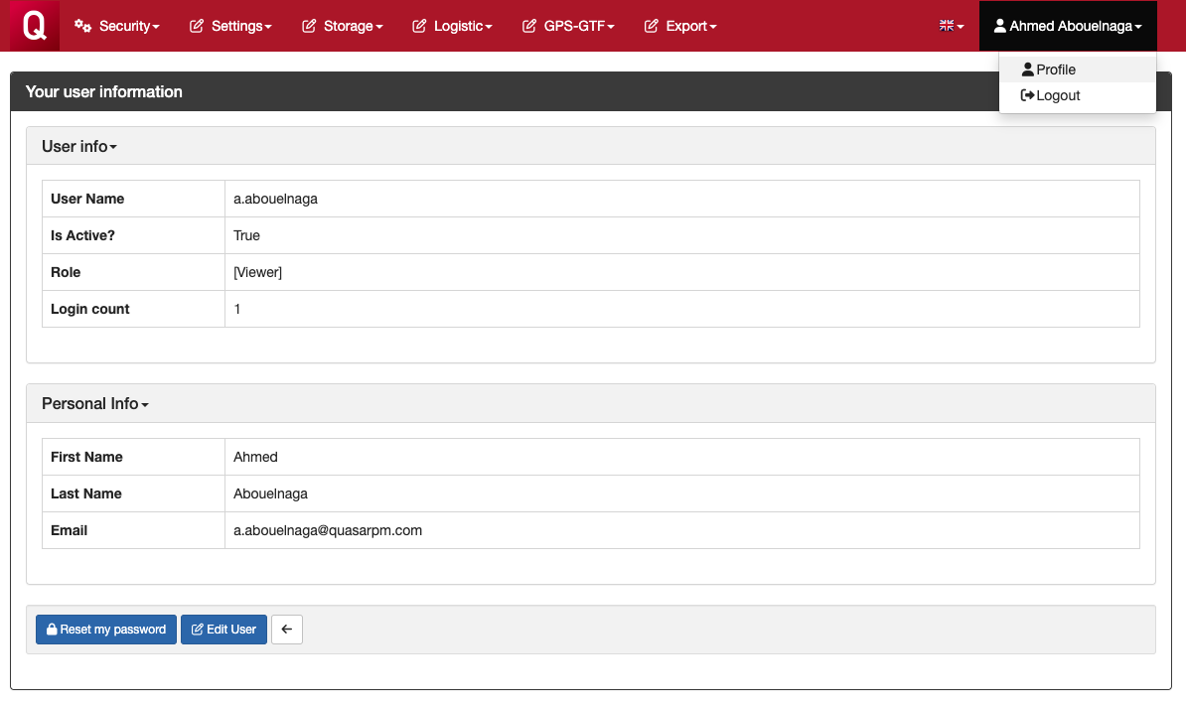
Password Reset
Upon the first login, it is important to change the system password to one of your own choosing.
Passwords can include alphanumeric characters and symbols.
Enter your user profile and click on "Reset my password."

Slide 4
User Interface

Slide 5
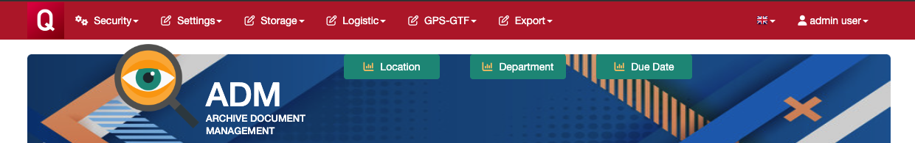
Main Menus
Security
Users and Roles Management
Settings
Account, Projects, Group/Department and Retention Codes Management
Storage
Box and Documents Management
Logistic
Site, Area and Section Management
GPS-GTF
Procedures and Forms Managements
Export
Data exporting in Standard Formats (as for GPS-GTF)

Slide 6
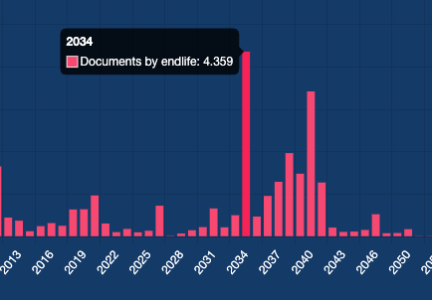
Dashboards
Location
Boxes by Location
Department
Records by Group/Department
Due Date
Records by Due Date
All charts allow the export of their respective records. For example, "all records with retention date 2034".

Slide 7
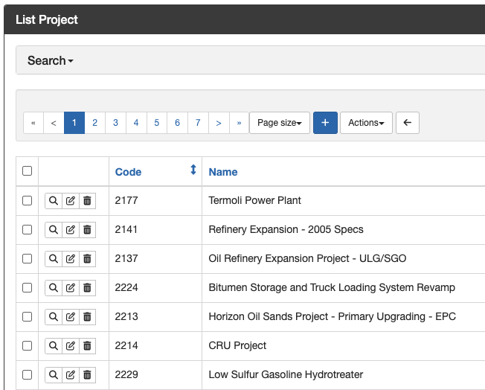
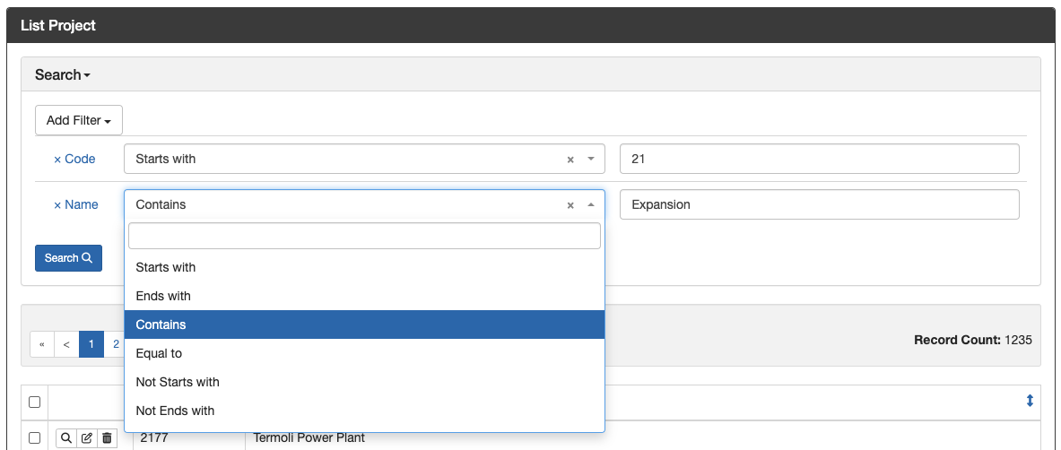
Records List
Search by Filter
All views allow the management of records:
Create a new record (icon: +)
Show a record (icon: magnifying glass)
Edit a record (icon: edit)
Delete a record (icon: delete)
All views allow the search of records by applying one or more conditional filters.

Slide 8
Setup

Slide 9
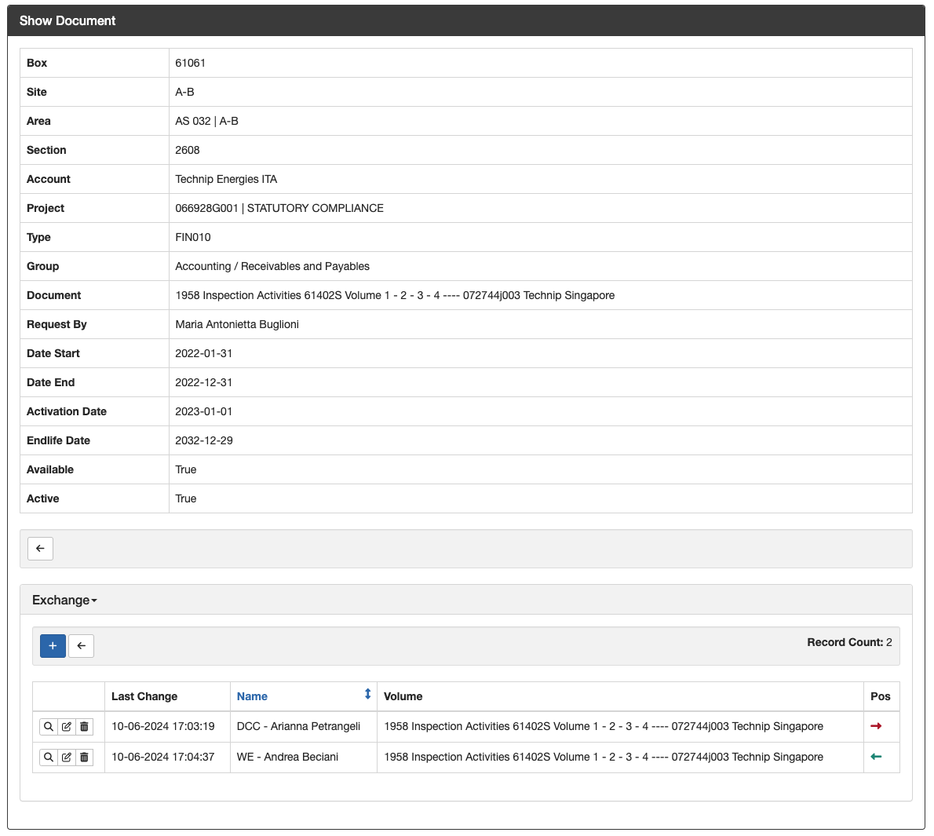
Logistic Setup
Account
Site 1
Area 1
Section 1
Section 2
Area 2
Section 3
Box 1
Box 2
Doc Record 1
Doc Record 2
Doc Record 3
Box 3
Section 4
Site 2
Area 3
Section 5
Section 6
Area 4
Section 7
Section 8
Doc Record 4
Doc Record 5
Doc Record 6
ADM allows the setup of logistics according to the following rules:
Each Account can have one or more Sites.
Each Site can have one or more Areas.
Each Area can have one or more Sections.
Each Section can have one or more Boxes.
Each Box can contain one or more Records.
The retrieval and return of documents are recorded in the Exchange view.

Slide 10
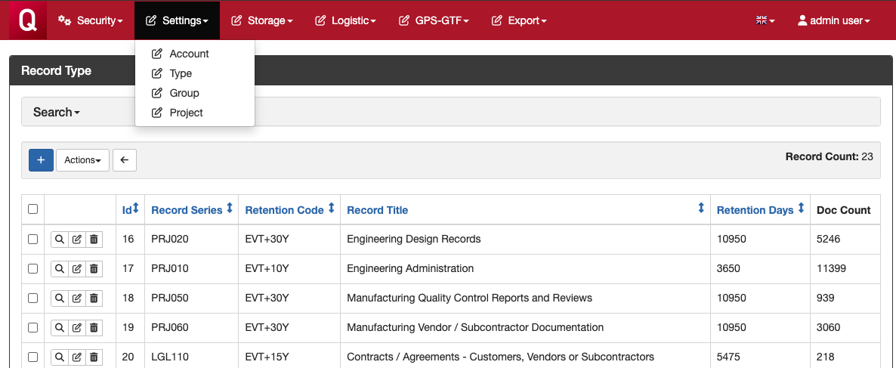
Settings
For each record, the following information are mandatory:
Project: The reference project.
Type: The reference record series according to GPS-GTF.
Group: The reference group or department.
You can manage the options for these fields from the Settings menu.

Slide 11
New Document Record

Slide 12
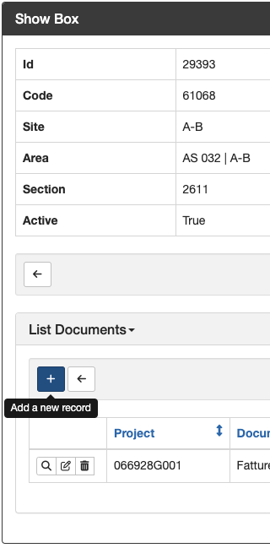
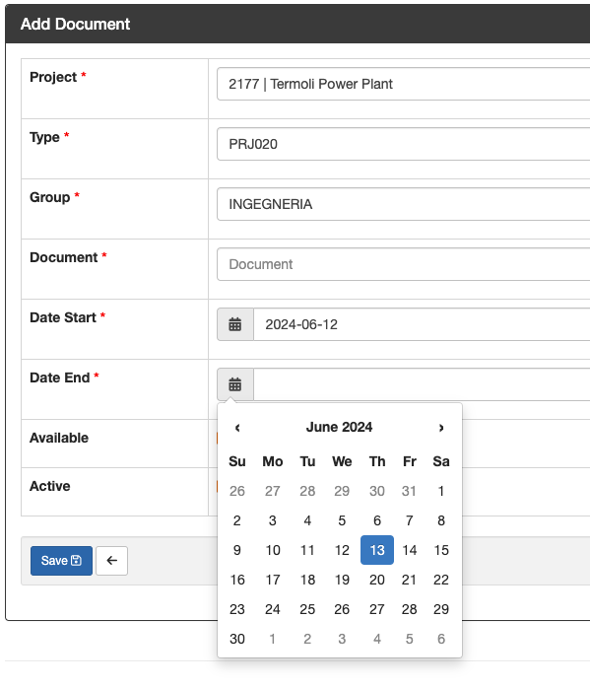
Add Doc. Records
Once the Logistic and Settings are set up, to add a new document record:
Search the box container by Box Code.
Open the box by clicking on the show icon.
Click on + on the relevant Document List View.
Fulfill all the relevant information as for GPS-GTF.
Click the Save button.
Fields marked with a red asterisk (*) are mandatory.

Slide 13
ADM Support
For support requests, please send an email to:
support@adm.quasarpm.com

